Slide 1

Data Visualization of Bird Strikes between 2000-2011

Slide 2
Project Detail
Project Title | Data Visualization of Bird Strikes between 2000-2011
Technology | Business Intelligence
Domain | Transportation and Communication
Project Difficulty Level | Advanced
Programming Language Used | Python
Tools used | Jupyter Notebook, MS-Excel, MS-PowerBI

Slide 3
Objective
Transport and communication is one of the crucial domain in field of analytics. Environmental impacts and safety are, nowadays, two major concerns of the scientific community with respect to transport scenarios and to the ever-growing urban areas. These issues gain more importance due to the increasing amount of vehicles and people. Seeking for new solutions is reaching a point where available technologies and artificial intelligence, especially MAS, are being recognized as ways to cope and tackle these kinds of problems in a distributed and more appropriate way.
A bird strike is strictly defined as a collision between a bird and an aircraft which is in flight or on a take-off or landing roll. The term is often expanded to cover other wildlife strikes - with bats or ground animals. Bird Strike is common and can be a significant threat to aircraft safety. For smaller aircraft, significant damage may be caused to the aircraft structure and all aircraft, especially jet-engine ones, are vulnerable to the loss of thrust which can follow the ingestion of birds into engine air intakes. This has resulted in several fatal accidents. Bird strikes may occur during any phase of flight, but are most likely during the take-off, initial climb, approach and landing phases due to the greater numbers of birds in flight at lower levels

Slide 4
Problem Statement
The goal of this project is to analyse the bird strike incidents happened between 2000-2011. To achieve the goal, we used a data set that is collected by FAA during 2000-2011. The objective of the project is to perform data visualization techniques to understand insights of the data. This project aims apply various Business Intelligence tools such as Tableau or Power BI to get a visual understanding of the data.

Slide 5
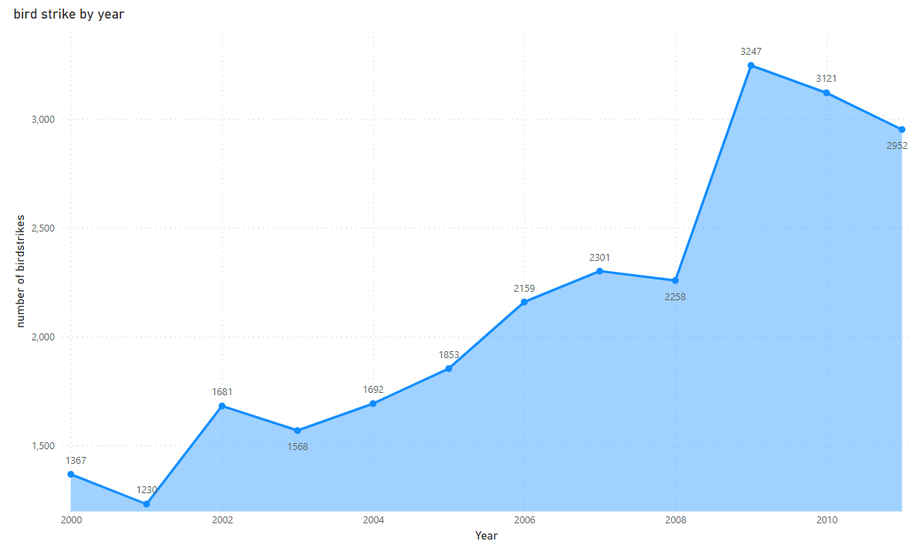
Insights
Total Number of Bird Strikes Incidents per Year
We can see that Bird Strikes Incidents have an upward trend 2009 has the highest number of incidents.
Number of Bird Strikes trended up between 2005 and 2011 with a rise of 1,099.
Small birds are affecting more on the strikes. 2009, 2010 & 2011 are the year where most strikes occurred

Slide 6
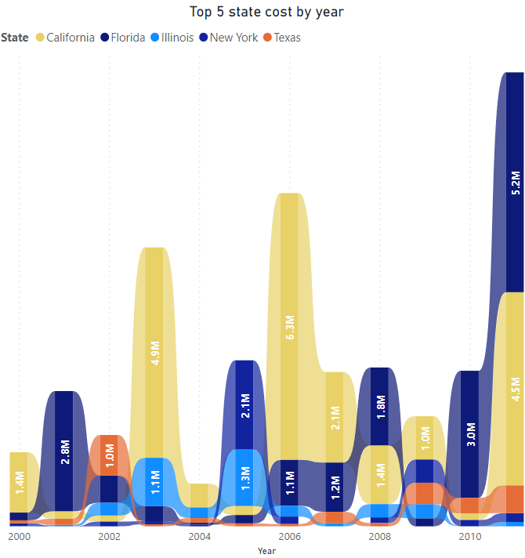
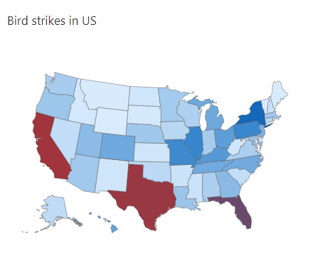
Bird Strikes Incidents in US
California, Texas and Florida has the highest number of bird strike incidents.

Slide 7
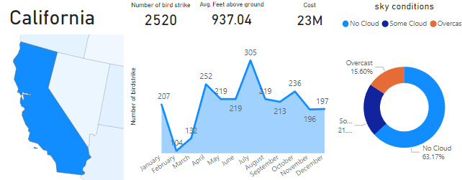
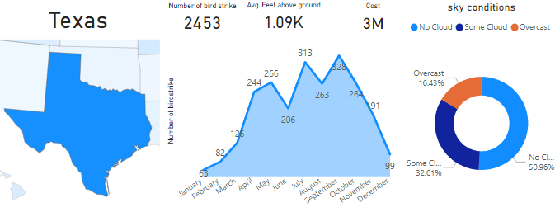
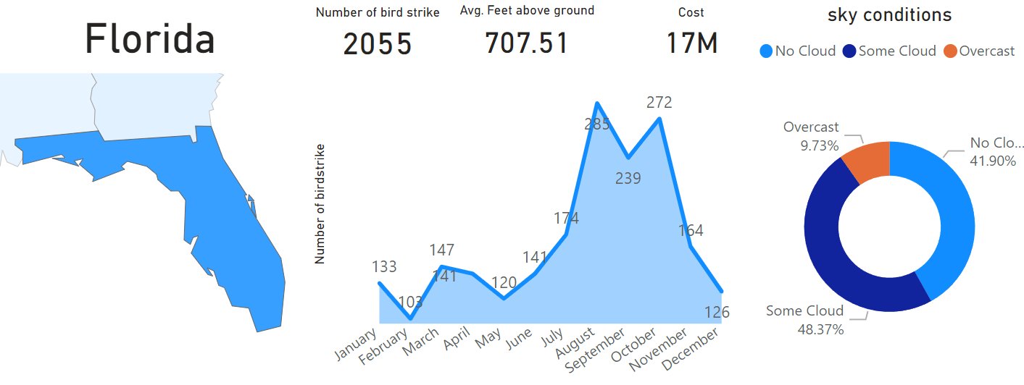
Bird Strikes Incidents in US
California has the highest bird strike cases
Cost of damage due to bird strike is also highest
In Max bird strikes incident the sky was clear
Worst month for bird strike is July
Texas is the 2nd highest bird strike cases
Cost of damage far less compared to California and Florida
In Max bird strikes incident the sky was clear
Worst month for bird strike is September
Florida is the 3rd highest in bird strike cases
Cost of damage due to bird strike is 2nd highest
In Max bird strikes incident the sky had some clouds
Worst month for bird strike is August

Slide 8
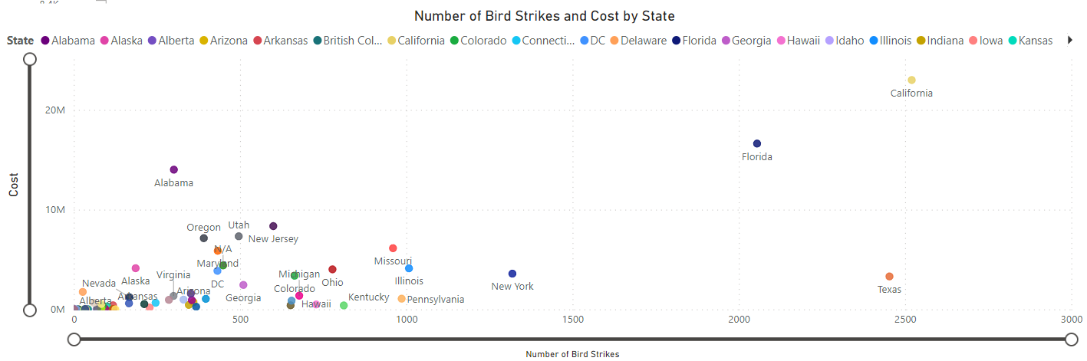
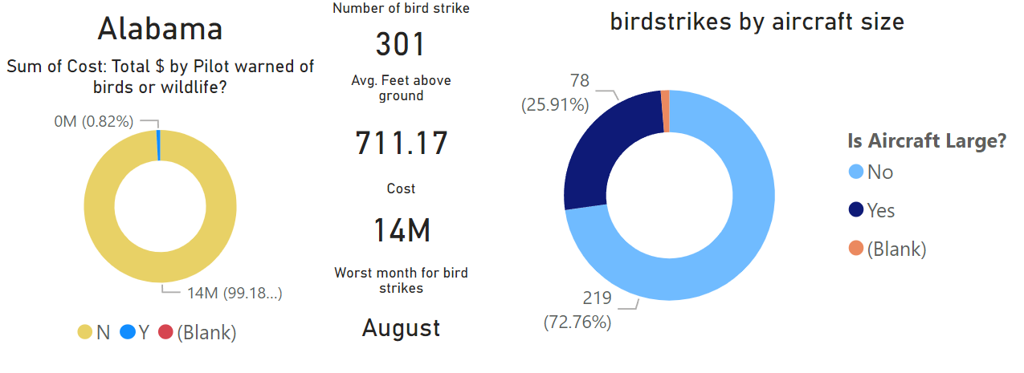
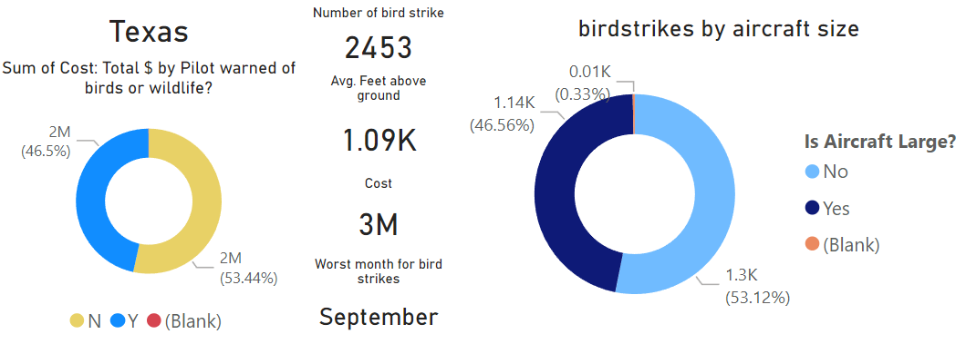
Bird Strikes Incidents in US
Alabama has less than 301 bird strike incident but cost of damage is 14M
Alabama has the 3rd highest cost of damages
Almost all of the cases where aircraft was damaged the pilots were not warned
Worst month for bird damage cases is August
Small aircraft are far more affected by birdstrikes
Texas has much more bird strike incident (2453) but cost of damage is 3M
Texas has the 3rd highest records of bird strikes
Texas does much better job in warning the pilots compared to Alabama
Worst month for bird damage cases is September
Small and large aircrafts are equally affected by bird strikes in texas

Slide 9
Top 10 Airlines having encountered most number of bird strikes
Southwest airlines has encountered most number of bird strike followed by business and American airlines
Except for southwest airlines all other birdstrike incidents are dominated my small sized aircraft

Slide 10
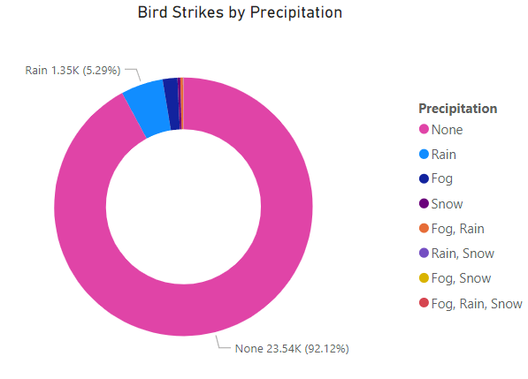
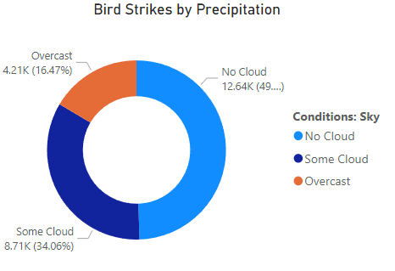
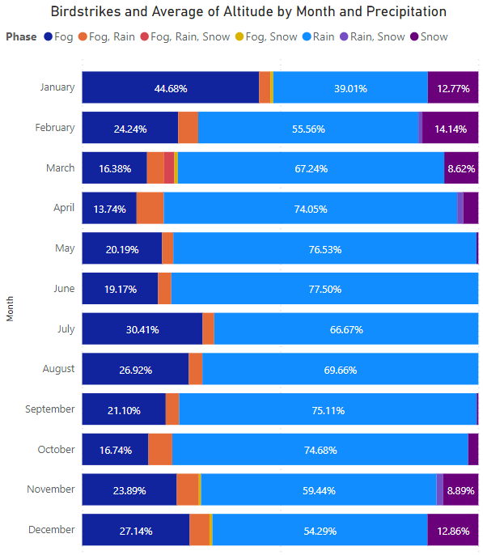
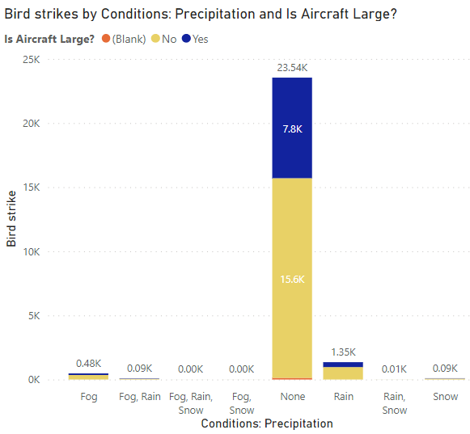
When do most bird strike incidents occur?
Most of the incidents have happened when there was no cloud in each year
Majority of the bird strikes cases have no precipitation conditions
The most common Precipitation conditions for the strike are rain followed by fog
Precipitation conditions effect aircraft size
Between May to September Rain dominates the precipitations condition that happen during the bird strike

Slide 11
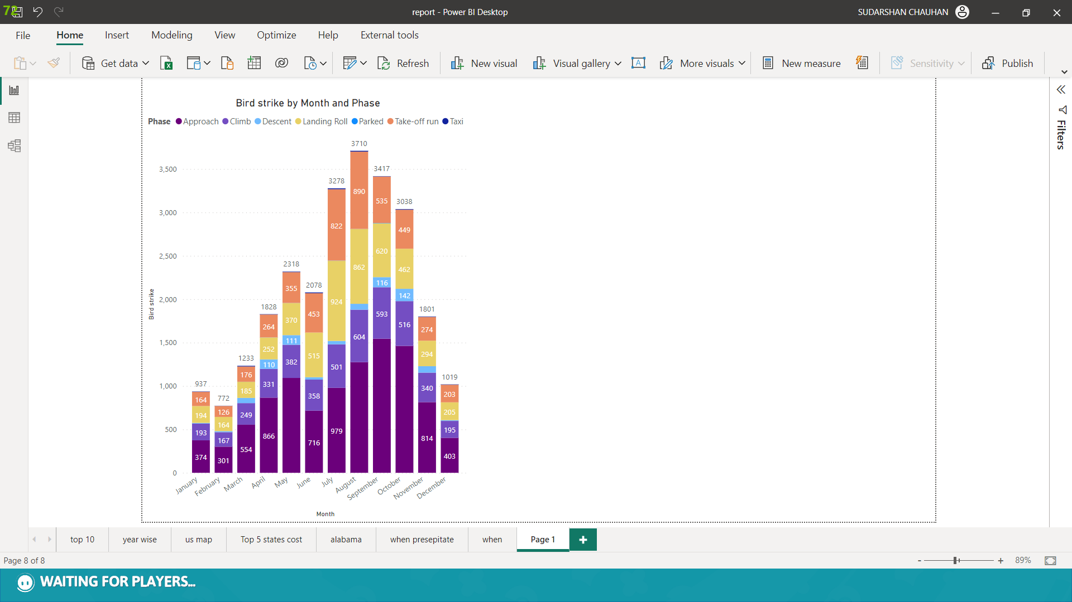
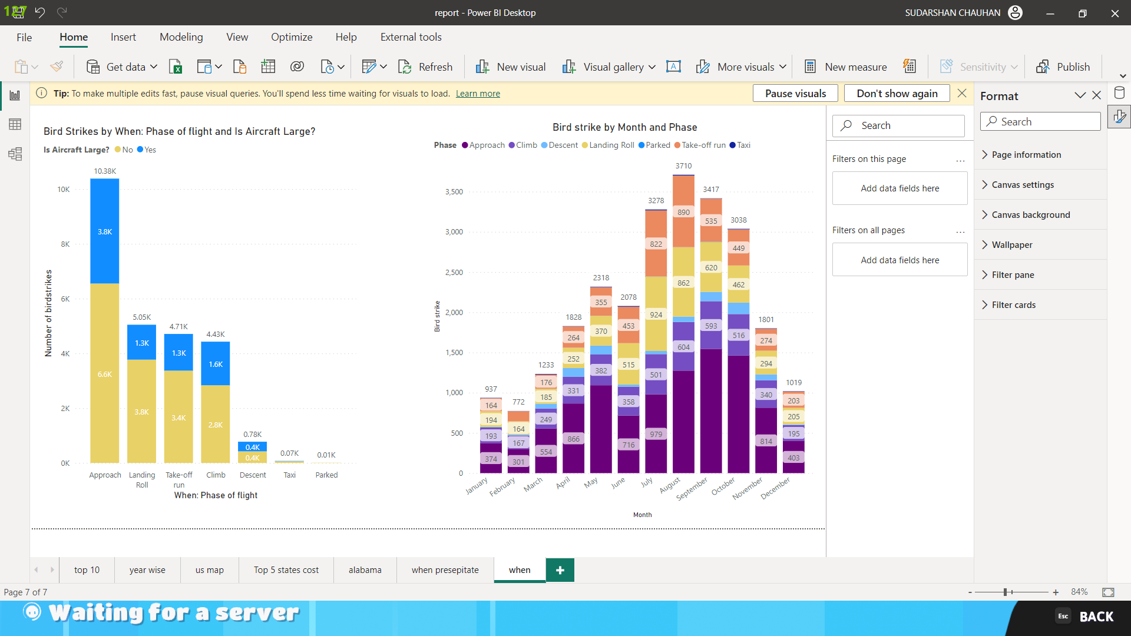
Phase of Flight at the time of strike
Total Count of bird strike was higher for small aircraft (17,027) than the large ones (8402).
﻿﻿﻿Approach in Aircraft size made up 25.77% of the bird strikes cases.﻿﻿ ﻿
﻿ ﻿﻿Average number of bird strikes was higher for small aircrafts (2,432.43) than large ones (1,400.33).﻿
Number of bird strikes for No and Yes diverged the most when the When: Phase of flight was Approach, when No were 2,722 higher than Yes.
﻿Bird strike for Parked started trending up on July 2000, rising by 100.00% (2) in 2 months.

Slide 12
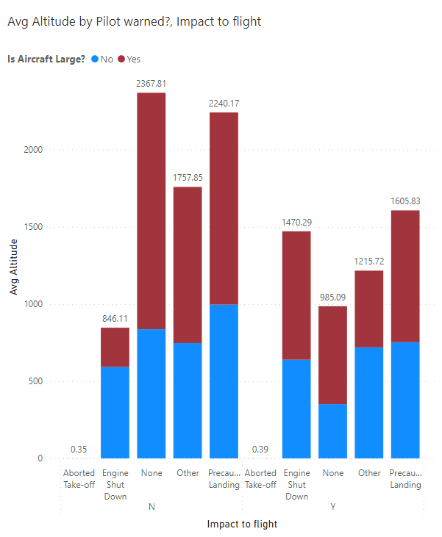
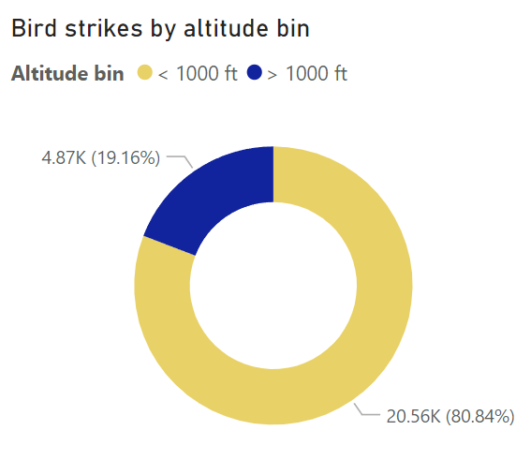
Altitude of Airplane at the time of bird strike
Between January 2000 and December 2000, Descent trended up with a 108.92% increase, followed by Climb and Approach.﻿
﻿The most recent Average of Altitude anomaly was in April 2000, when Take-off run had a high of 1.14.
﻿Across Phase, Approach had the most interesting recent trend and started trending up on June 2000, rising by 95.90% (580.47) in 5 months.
80.84% of bird strike incidents have happened when the altitude of airplane was <1000 ft and 19.16% have happened when altitude was >1000 ft.

Slide 13
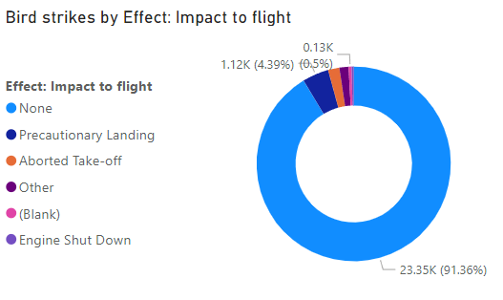
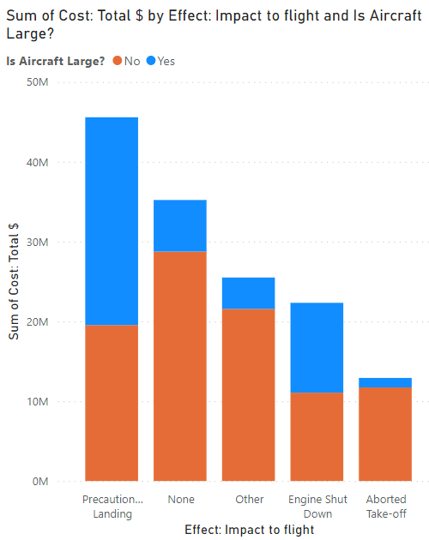
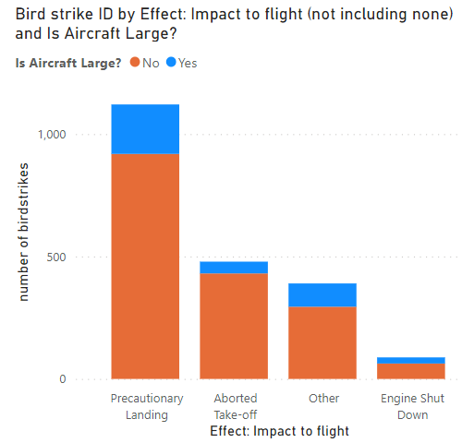
Impact on Flights
Total Sum of Cost: Total $ was higher for No (92665917) than Yes (48881261).﻿
None in Is Aircraft Large? made up 20.31% of Sum of Cost: Total $.
Average Sum of Cost: Total $ was higher for No (1,85,33,183.40) than Yes (97,76,252.20).
﻿Sum of Cost: Total $ for No and Yes diverged the most when the Effect: Impact to flight was None, when No were 22290594 higher than Yes.
91.83% incidents where there was no impact on flights
Total number of bird strikes was higher for No (1,708) than Yes (370).
﻿Precautionary Landing in Is Aircraft Large? made up 44.23% of number of birdstrikes.
Average number of bird strikes was higher for No (427) than Yes (92.50).
Number of bird strikes for No and Yes diverged the most when the Effect: Impact to flight was Precautionary Landing, when No were 717 higher than Yes.

Slide 14
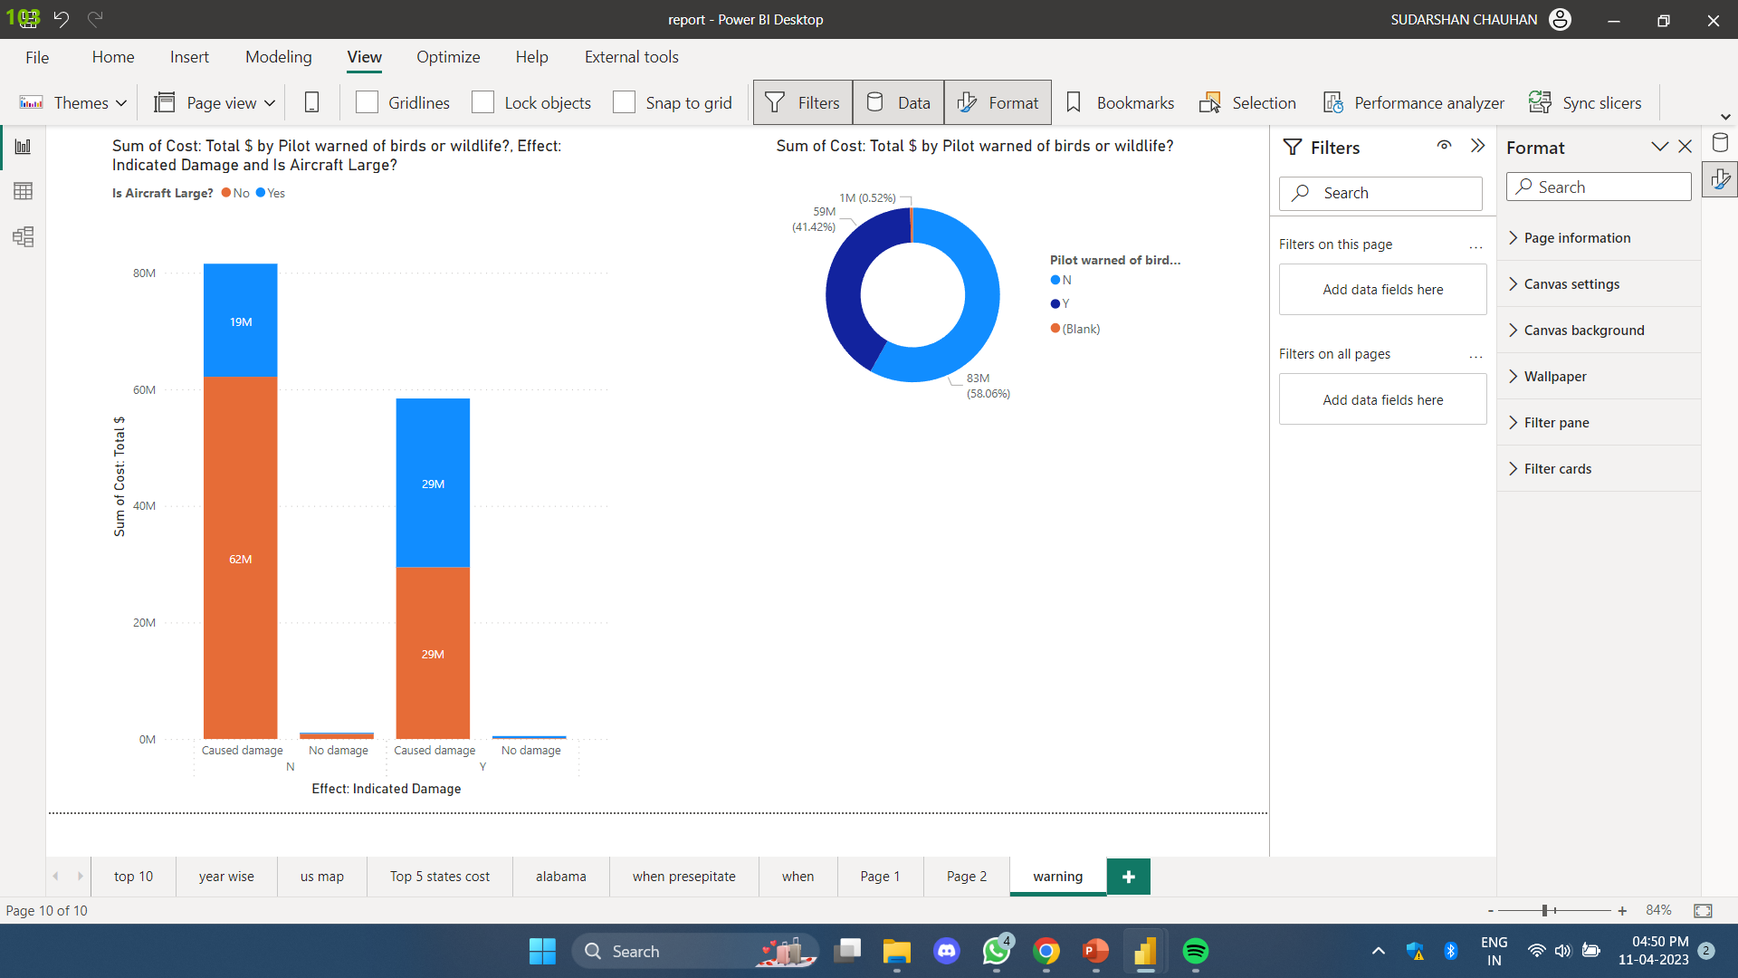
Does prior warning reduces the effect of damage?
Prior warning seems to help avoid damage more in case of small aircraft
Even with higher bird strikes cases Texas avoid high damage by prior warning compared to Alabama
Cost of damages is reduced in case of prior warning

Slide 15
Conclusion
Strikes occurred during Summer(August) & Autumn(September) seasons, when sky has no cloud.
South Airlines faced the more strikes.
DALLAS airport faced the most strikes
Most number of strikes occurred in the month of August.
Prior warning to the pilot reduces the risk of damage to the aircraft, especially in case of small aircrafts
During the Approach phase of the flight, most bird strikes occurred.
California & Texas are the states where most strikes occurred.
Bird Strikes Incidents have an upward trend 2009 has the highest number of incidents.
52.78% of incidents have happened due to some small unknown bird.
72.9% incidents have happened when there is 1 bird/wildlife is struck in the airplane and caused damage.
90.31% incidents caused no damage while 9.69% incidents caused damage
80.84% of bird strike incidents have happened when the altitude of airplane was <1000 ft and 19.16% have happened when altitude was >1000 ft.
Most of the incidents have happened when there is no cloud in each year
Southwest airlines has encountered most number of bird strike followed by business and American airlines
Except for southwest airlines all other bird strike incidents are dominated my small sized aircraft

